Slide 1
Getting a grip on recursion
“To understand recursion, one must first understand recursion”
Terence Parr
MSDS program University of San Francisco

Slide 2
Recursion is just delegation
Consider an org chart
Bosses delegate to subordinates
CEO wants work done:
sends emails to 2 VPs
who launch 2 other workers
those workers launch emails too
until potentially all n contacted
Max work is n workers times work each worker performs
Trace from CEO to mailroom cost is just height of org chart: log(n) in typical case
Example: phone tree
Jeff

Slide 3
Recursion is more like startup org chart
One person has to play every role, cloning themselves
Person ”pauses” current work, performs subtask(s), then continues where they left off, possibly using subtask results
Each call or email to worker is analogous to a function call
(A large company could launch multiple core/employees)

Slide 4
Let’s start with math recurrence relations
Factorial definition:
Let 0! = 1
Define n! = n * (n-1)! for n>=1
Recurrent math function calls become recursive function call in Python
Non-recursive version is harder to understand and less natural
This has linear time O(n); more clear in non-recursive version T(n) = k + T(n-1) = kn
def fact(n):
if n==0: return 1
return n * fact(n-1)
def factloop(n):
r = 1
for i in range(1,n+1):
r *= i
return r

Slide 5
Fibonacci sequence
def fib(n):
if n==0 or n==1: return 1
return fib(n-1) + fib(n-2)
Let F(0) = F(1) = 1
Define F(n) = F(n-1) + F(n-2) for n>=2
Recursive implementation is very natural but mucho inefficient!
We do small bit of work to combine results of two subproblems, and each subproblem is only 1 and 2 elements smaller
Compare this to fact(n) where we do small bit of work using result of a single subproblem, which has linear time

Slide 6
Compare fact, fib call trees visually
Difference comes down to two versus one subproblem!
Key idea: recursion traces out a tree of function calls (meaning recursion is most natural way to walk trees)

Slide 7
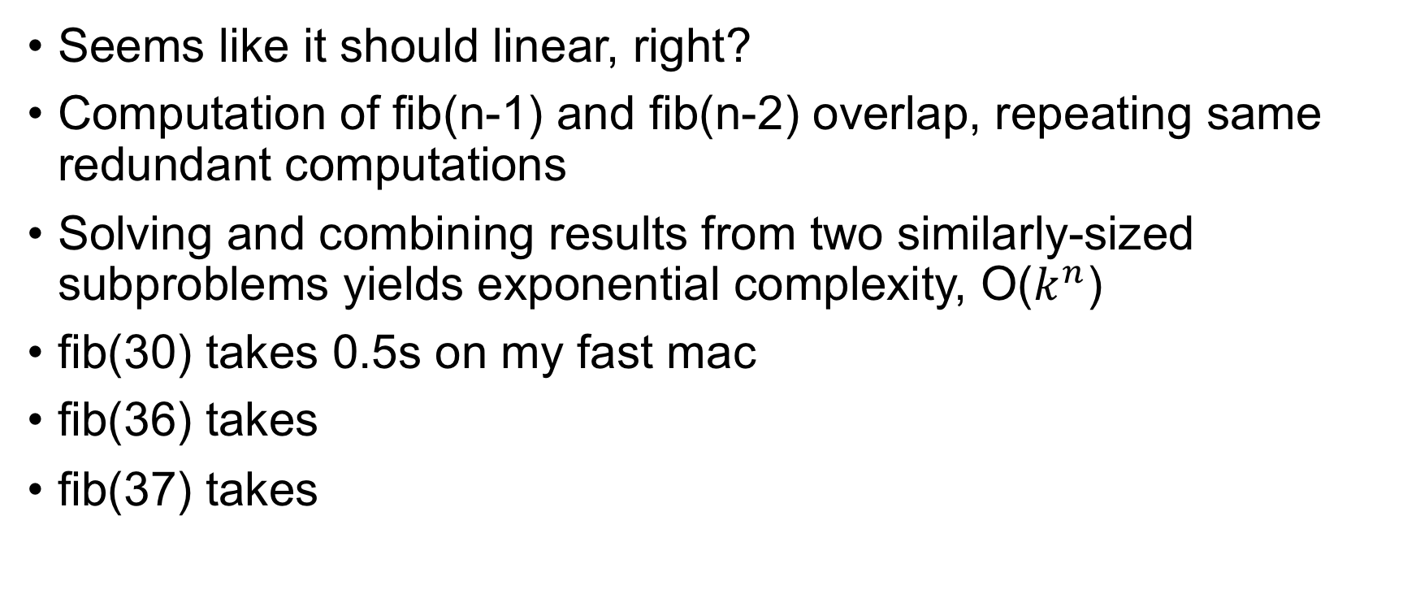
How fast is fib(n)?
def fib(n):
if n==0 or n==1: return 1
return fib(n-1) + fib(n-2)
Seems like it should linear, right?
Computation of fib(n-1) and fib(n-2) overlap, repeating same redundant computations
Solving and combining results from two similarly-sized subproblems yields exponential complexity, O($k^{n}$)
fib(30) takes 0.5s on my fast mac
fib(36) takes
fib(37) takes
9.0s
16.7s

Slide 8
Exercise
def fib(n):
if n==0 or n==1: return 1
return fib(n-1) + fib(n-2)
What is T(n) for fib() and show it’s exponential?
T(n) = k + T(n-1) + T(n-2)
T(n) = k + (k + T(n-2) + T(n-3)) + (k + T(n-3) + T(n-4))
T(n) = k + (k + (k + T(n-3) + T(n-4)) + (k + T(n-4) + T(n-5))) + (k + (k + T(n-4) + T(n-5)) + (k + T(n-5) + T(n-6)))
T(n) = 7k + T(n-3) + 3T(n-4) + 3T(n-5) + T(n-6)
Yikes! I don’t see the pattern, do you?
We could look at recursion tree; bushy tree height n has 2^n nodes, or…

Slide 9
Proof by “complete induction”
Try T(n) = 2^n; it’s a good bet given the explosion of computations then prove by induction
Complete induction: Assume T(i)=2^i holds for all i<n
Observe that T(n+2) = T(n+1) + T(n)
Complete induction assumption lets us directly substitute:
T(n+2) = 2^(n+1) + 2^n = 2^1*2^n + 2^n = 2^n(2 + 1)
So T(n) = 3*2^n, which is O(2^n)

Slide 10
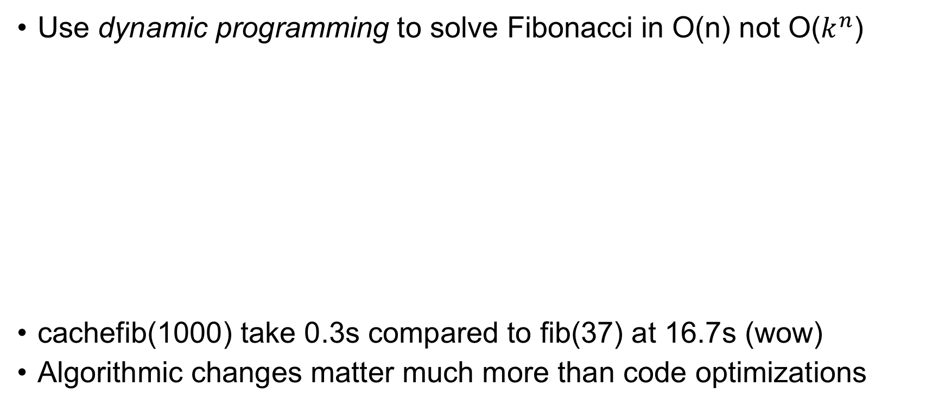
An aside: Trade memory for speed
Use dynamic programming to solve Fibonacci in O(n) not O($k^{n}$)
cachefib(1000) take 0.3s compared to fib(37) at 16.7s (wow)
Algorithmic changes matter much more than code optimizations
def cachefib(n):
F = [0 for i in range(n+1)]
F[0] = F[1] = 1
for i in range(2,n+1): # work up not down
F[i] = F[i-1] + F[i-2]
return F[n]

Slide 11
Summary: formula for recursive functions
def f(input):
1. check termination condition
2. process the active input region / current node, etc…
3. invoke f on subregion(s)
4. combine and return results
Steps 2 and 4 are optional
def fact(n):
if n==0: return 1
return n * fact(n-1)
def fib(n):
if n==0 or n==1: return 1
return fib(n-1) + fib(n-2)
Terminology: currently-active region or element is what function is currently trying to process.
Here, that is argument n (the “region” is the numbers 0..n)

Slide 12
Recursion at its finest: Divide and conquer
The big idea: break a big problem down into smaller subproblems via recursion until subproblems are so small we can solve in constant time; then, merge partial results in linear time as you climb back up the recursive calls
Examples: merge sort, quick sort, decision tree construction
Recursion is easiest way to describe algorithms that break problems into multiple subproblems
In contrast, algorithms that use a single recursive call are easy to convert to loops, and loops are usually more efficient

Slide 13
The nature of divide and conquer alg’s
Divide and conquer algorithms make 2 or more recursive calls where each subproblem is a fraction of the size of the currently active problem
(Binary search splits problem in half each step but it descends into just one half with one recursive call not two and it doesn’t merge results; technically, not divide and conquer…just divide)
The cost of any recursive algorithms depends on:
the number of recursive subproblem calls per active region
the size of the subproblems; for example, n-1 or n/2 for active size n?
the work required for each active region

Slide 14
Merge sort O(n log n)
The idea is to split currently active region in half, sorting both the left and right subregions, then merge two sorted subregions
Eventually, the regions are so small we can sort in constant time; i.e., sorting 2 nums is easy
Merging two sorted lists can be done in linear time
https://www.hackerearth.com/practice/algorithms/sorting/merge-sort/visualize/

Slide 15
Algorithm is simple but efficient (nlogn)
def msort(A):
if len(A)==1:
return A
if len(A)==2:
return A if A[0]<A[1] else [A[1],A[0]]
mid = int(len(A)/2)
left = msort(A[:mid])
right = msort(A[mid:])
return sorted(left + right)
“sorted(left + right)” is cheating but used for simplicity here; merging two sorted lists is O(n)
(Note: constant on this is huge)

Slide 16
Exercise: write pow2(n)
Compute 2^n recursively by multiplying 2 together n times
Now do iterative version
def pow2(n):
if n==0: return 1
return 2 * pow2(n-1)
def pow2(n):
v = 1
for i in range(n): v *= 2
return v

Slide 17
Can we do pow2 more efficiently?
Divide and conquer; hint 2^n = 2^(n/2) * 2^(n/2) if n is even If n odd, it’s 2 times 2^floor(n/2)
A non-recursive version would awkward and hard to write!
def pow2(n):
if n==0: return 1
half = pow2(int(n/2))
if n % 2==0: # if even
return half * half
return 2 * half * half

Slide 18
Recursion summary
Use recursion when implementing a recurrence relation (not always for efficiency reasons, such as gradient descent)
Use recursion when you can break problem down into subproblems whose results can be merged to solve overall problem; divide and conquer
Use recursion when the same operation and navigation procedure applies to any element of a data structure; binary search, walking trees and graphs; self-similar structures
Recursion traces out a function call tree

